Slide 1
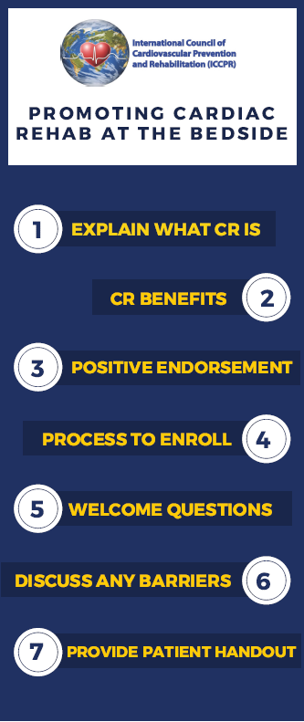
How YOU can help
Refer
All eligible patients
> Discharge order sets
> Outpatients with qualifying diagnosis
> Goal: within 21 days
Recommend
All eligible patients
> Provider recommendation is one of the strongest predictors of participation
Pio et al. Cochrane Reviews. 2019
Thomas et al. Circ CQO. 2018
Notes:
However, there is a strong body of literature on efficacious interventions to increase enrolment in cardiac rehabilitation. You, as a clinician, can refer all eligible patients. This is best achieved by implementing automatic referral for qualifying diagnoses through ordersets, with cardiac rehab checked as a default so that providers have to opt-out, rather than opt-in.
In the most recent performance measures, the goal is to have patients enroll in CR within 21 days.
However, in addition to referring all patients, a provider recommendation is of paramount importance. Strength of provider recommendation is one of the strongest predictors of participation. Additionally, interventions that include liasons that help facilitate the recruitment and enrollment of patients are efficacious in increasing enrolment.
You can have this conversation with patients through 7 steps – Explain what CR is, describe the benefits, provide a positive endorsement, explain the process to enroll, welcome questions, discuss any barriers, and provide the patient with more information. In the course syllabus, you will find in the final slide the “script” that I use for encouraging patients to enroll in cardiac rehab.

Slide 2
Sample Referral Script
EXPLAIN WHAT CR IS: Cardiac rehab is a program of exercise training and health behavior counseling for people with heart conditions. You attend {group exercise sessions three times a week for 12 weeks/telehealth sessions once per week for 12 weeks/a mix of group exercise sessions and telehealth sessions for 12 weeks} and work with our nurses, exercise physiologists, nutritionists, pharmacists, and mental health providers. Cardiac rehab is supervised, extremely safe, and tailored to the individual person – we meet you where you are to help you gradually improve you heart health.
CR BENEFITS: Cardiac rehab improves your exercise capacity and makes you feel better. People who participate are also less likely to return to the hospital (and live longer).
POSITIVE ENDORSEMENT: I strongly recommend that you participate in cardiac rehab.
Notes:
)

Slide 3
Sample Referral Script
PROCESS TO ENROLL: I put in a referral to cardiac rehab in the computer. Our cardiac rehab center will call you to schedule an initial visit.
WELCOME QUESTIONS: What questions do you have about cardiac rehab?
DISCUSS ANY BARRIERS: What concerns do you have about going to cardiac rehab?
PROVIDE HANDOUT: I am going to put the link for the cardiac rehab center in your After Visit Summary
I think this will be a great program for you because…!

